Slide 1
Applied data science capstone
Peiwen Guan
November 24, 2022
Github link: Coursera/Applied Data Science Capstone at main · hi2e3g/Coursera (github.com)

Slide 2
table of contents
Project Introduction
Data Collection and Data Wrangling
Exploratory Data Analysis (EDA)
Interactive Visual Analytics and Dashboard
Predictive Analysis (Classification)
Conclusion
Reference

Slide 3
Applied Data Science Capstone by IBM Skills Network
This is the final course in the IBM Data Science Professional Certificate as well as the Applied Data Science with Python Specialization. Student will practice the work that data scientists do in real life when working with datasets.
In this course student will assume the role of a Data Scientist working for a startup intending to compete with SpaceX, and in the process follow the Data Science methodology involving data collection, data wrangling, exploratory data analysis, data visualization, model development, model evaluation, and reporting your results to stakeholders.

Slide 4
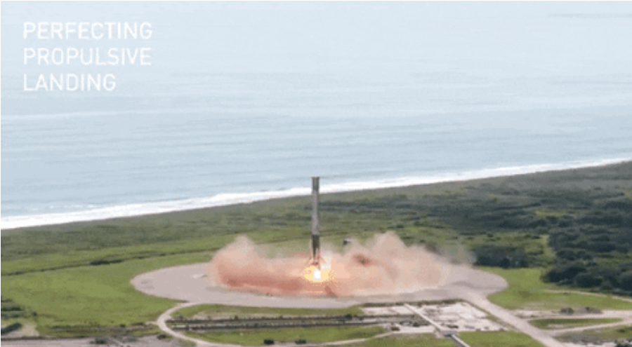
Data collection and data wrangling
Public API: API requests from Space X
Web Scraping: Wikipedia page about Space X
Data Wrangling: Land outcomes to be converted to Classes y(either 0 or 1). 0 is a bad outcome, that is, the booster did not land. 1 is a good outcome, that is, the booster did land.
Public API Methodology: Request (API) → Json →Data Frame → Data filtering ( Falcon 9) → Data cleaning (using mean value for missing Payload Mass values)
Web scraping Methodology: Request (html)→HTML parse → Extract key values → Dictionary format

Slide 5
Exploratory Data Analysis (EDA)
Collect data on the Falcon 9 first-stage landings
Create scatter plots and bar charts by writing Python code to analyze data in a Pandas data frame
Write Python code to conduct exploratory data analysis by manipulating data in a Pandas data frame
Write and execute SQL queries to select and sort data
Use your data visualization skills to visualize the data and extract meaningful patterns to guide the modeling process.

Slide 6
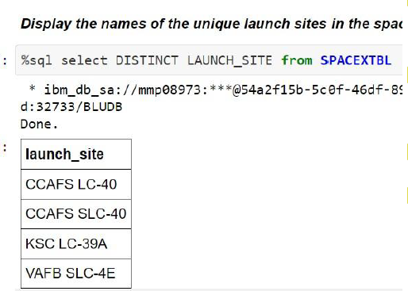
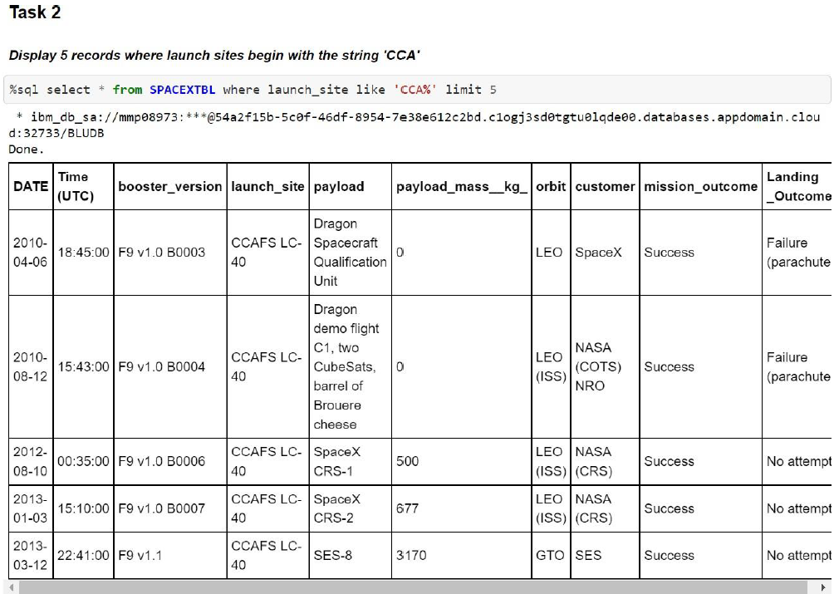
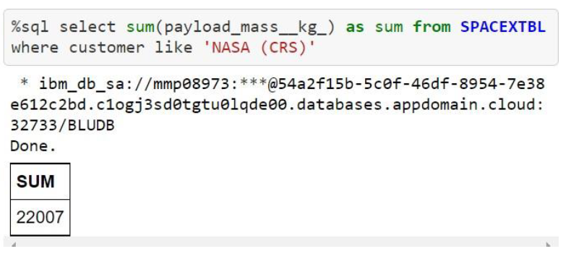
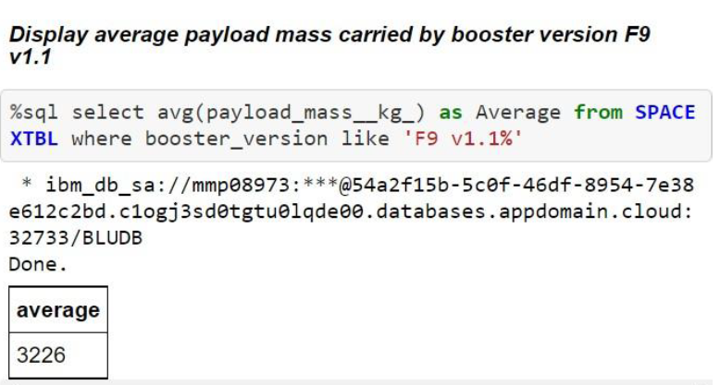
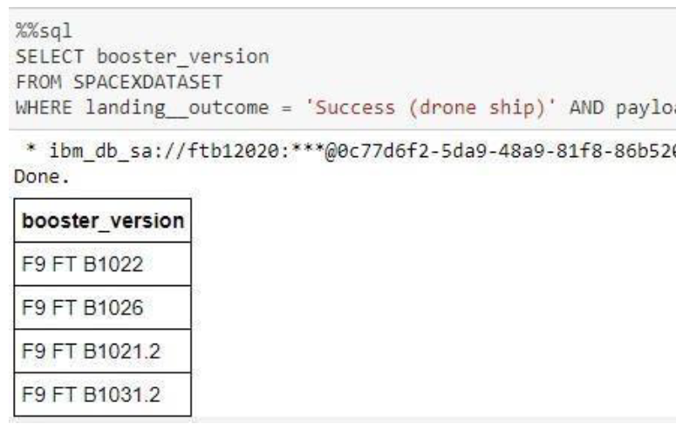
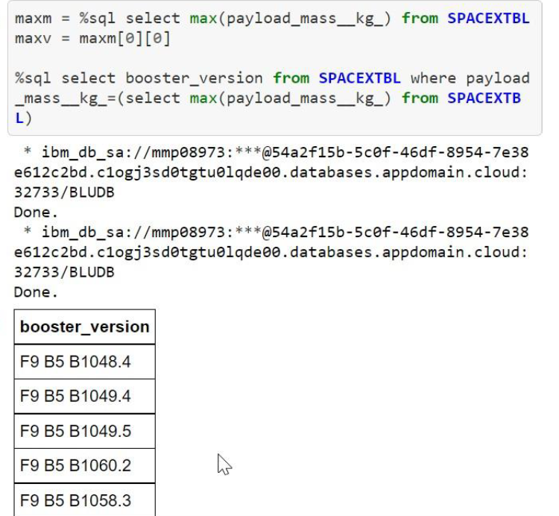
Exploratory Data Analysis (EDA) results

Slide 7
Interactive Visual Analytics and Dashboard
Build an interactive dashboard that contains pie charts and scatter plots to analyze data with the Plotly Dash Python library
Calculate distances on an interactive map by writing Python code using the Folium library
Generate interactive maps, plot coordinates, and mark clusters by writing Python code using the Folium library
Build a dashboard to analyze launch records interactively with Plotly Dash.
Build an interactive map to analyze the launch site proximity with Folium.

Slide 8
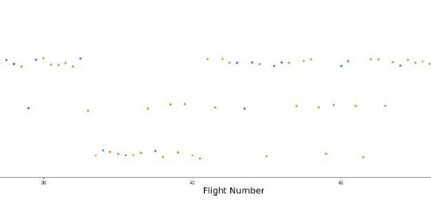
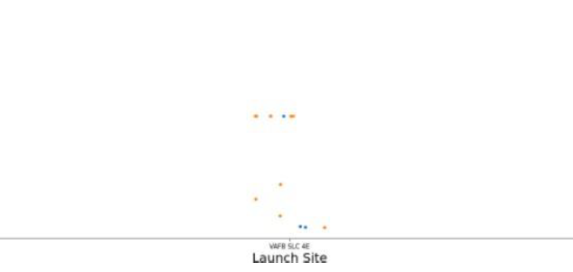
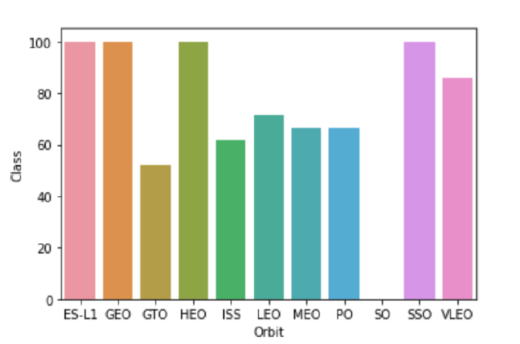
Interactive Visual Analytics and Dashboard
Flight Number vs. Launch Site
Payload vs. Launch Site
Success rate vs. Orbit type
Orange indicates successful launch, and blue indicates unsuccessful launch. CCAFS appears to be the main launch site as it has the most volume.
Orange indicates successful launch, and blue indicates unsuccessful launch. Payload mass appears to fall mostly between 0-7000kg. Different launch sites seems to use different pay load mass.
Based on the graphic , we can know ES-L1(1) ,GEO(1), HEO(1) have 100% success rate.

Slide 9
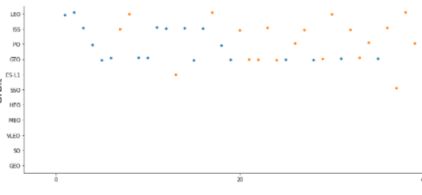
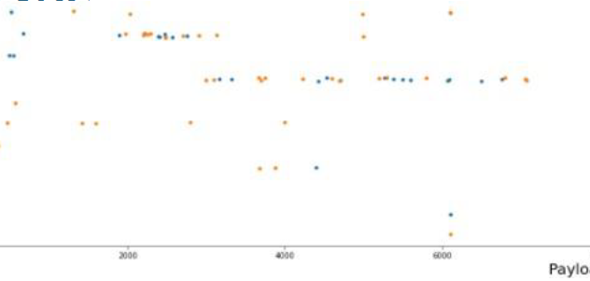
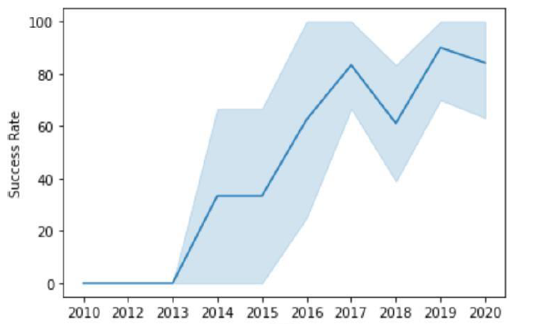
Interactive Visual Analytics and Dashboard
Flight Number vs. Orbit type
Payload vs. Launch Site
Launch Success Yearly Trend
Launch Outcome seems to correlate with this preference. SpaceX appears to perform better in lower orbits or Sun-synchronousorbits.
Payload mass seems to correlate with orbit. LEO and SSO seem to have relatively low pay load mass
After 2013, launch success generally increasing, which rate is almost 85%.

Slide 10
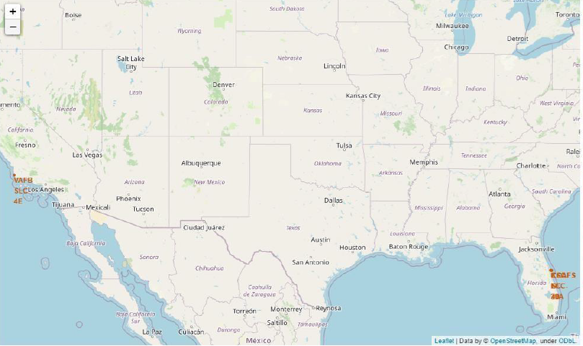
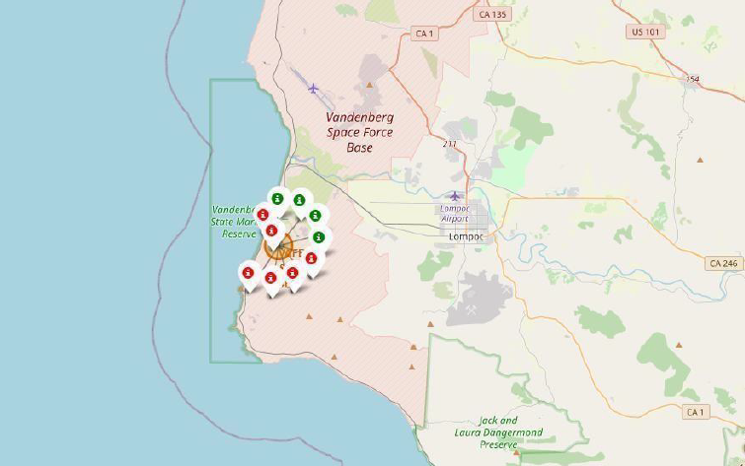
Interactive map with folium
Launch Site Locations in the U.S.
VAFBSLC-4E shows 4 times successful landings and 6 failed landings.

Slide 11
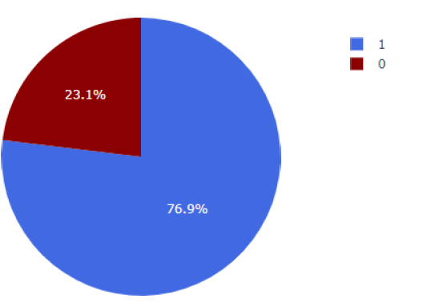
Interactive Visual Analytics and Dashboard
From the left pie chart, we can see KSC LC-39A has the highest success rate with 10 successful landings and 3 failed landings.

Slide 12
Predictive Analysis (Classification)
Split the data into training testing data.
Train different classification models.
Hyperparameter grid search.
Use your machine learning skills to build a predictive model to help a business function more efficiently.

Slide 13
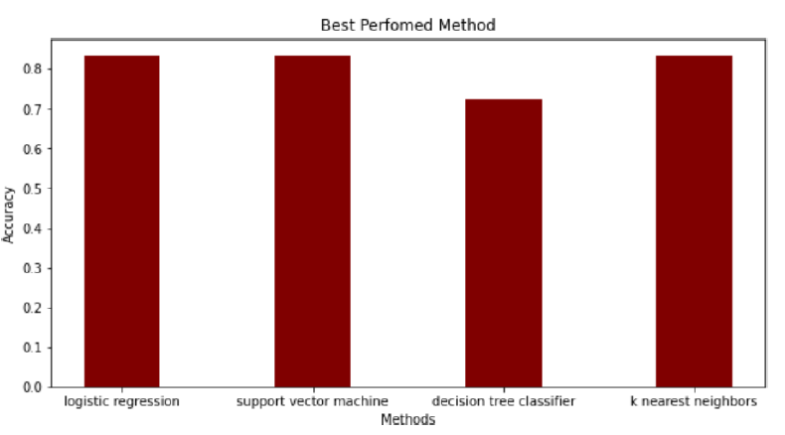
Predictive Analysis (Classification)
The models had virtually the same accuracy on the test set at 83.33% accuracy, except the decision tree classifier with 72,23%.
For more accurate prediction, we need more data for analyzing and train our models.

Slide 14
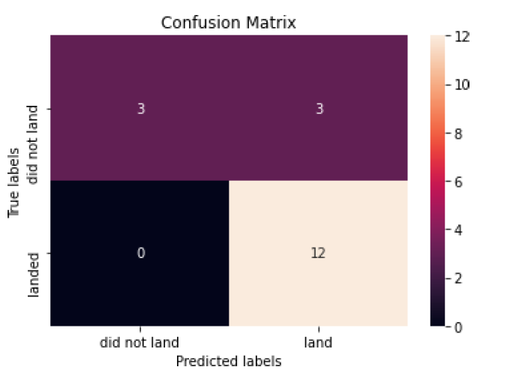
Predictive Analysis (Classification)
A confusion matrix is a tabular summary of the number of correct and incorrect predictions made by a classifier.
The model predicted 12 successful landings when the true label was successful landing.

Slide 15
CONCLUSION
In this course I am trying to be a data scientist by using the data from SpaceX, and in the process follow the Data Science methodology involving data collection, data wrangling, exploratory data analysis, data visualization, model development, model evaluation.

Slide 16
reference
Coursera/Applied Data Science Capstone at main · hi2e3g/Coursera (github.com)
Applied Data Science Capstone - Introduction | Coursera

